Slide 1




POVERTY
ESTIMATION

Slide 2

INTRODUCTION
Objective:
Develop a machine learning model to estimate poverty status based on socio-economic indicators.
SCOPE:
Data preprocessing and cleaning.
Exploratory Data Analysis (EDA).
Building and evaluating predictive models.
OUTCOME:
Classification of regions as "poor" or "non-poor" using a threshold-based approach.

Slide 3
SOURCE:
DATASET
Provided socio-economic dataset.
KEY FEATURES:
OVERWIEV
Poverty rates for 2001 and 2011.
Various socio-economic indicators (e.g., literacy rate, employment levels).
CHALLENGES:
Missing values.
Encoding categorical variables.
Normalizing data for model input.

Slide 4
PROCESSING STEPS
Data Cleaning:
Handled missing values using median imputation for numeric columns.
Feature Engineering:
Created binary target variable (poverty_status) based on a 20% threshold for poverty rates.
Encoded categorical variables using one-hot encoding.
Feature Scaling:
Applied standardization to normalize feature values for Random Forest.

Slide 5

Liceria Tech
MODELING APPROACH
Logistic Regression:
Suitable for binary classification.
Model trained on unscaled features.
Evaluated using metrics like accuracy, confusion matrix, and classification report.
Random Forest Classifier:
Leveraged feature importance.
Model trained on scaled features for better performance.

Slide 6
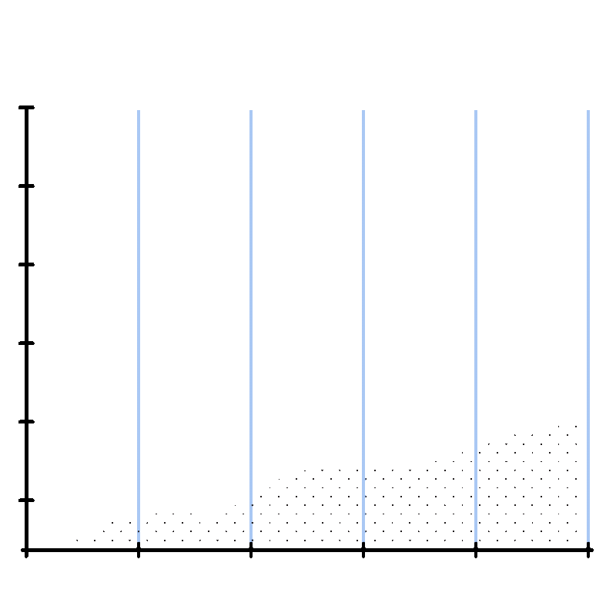
KEY
FINDINGS
High-performing features identified through Random Forest importance.
Logistic Regression provided interpretable coefficients.
Imbalanced data or threshold sensitivity may impact model performance.

Slide 7


CHALLENGES
Missing data required imputation.
Threshold selection for poverty status may not generalize well.
Limited by the features available in the dataset.

Slide 8

CONCLUSION
Successfully built models to estimate poverty status.
Demonstrated the impact of preprocessing on model performance.

Slide 9
THANK YOU!

